Slide 1

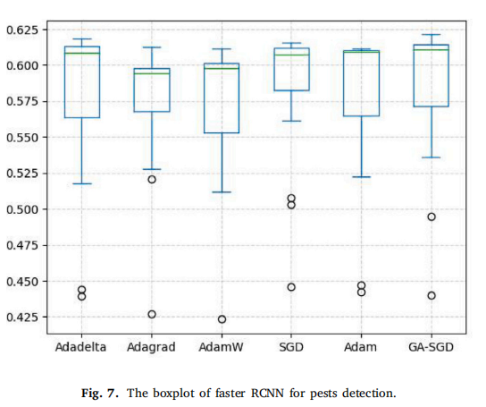

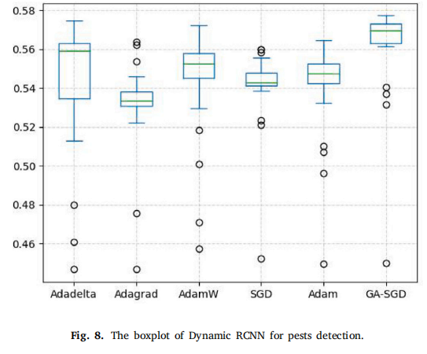
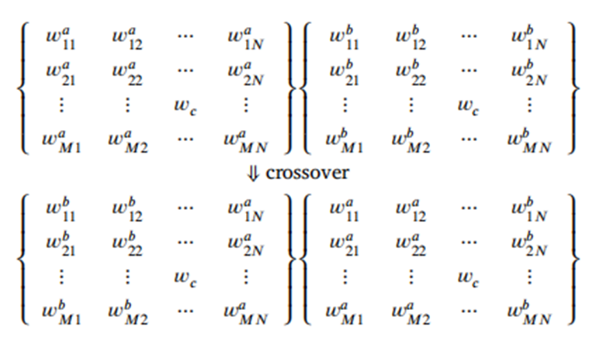
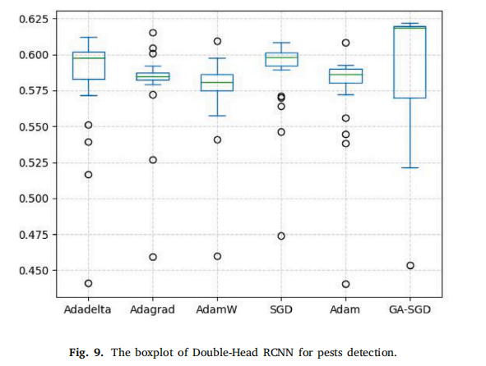
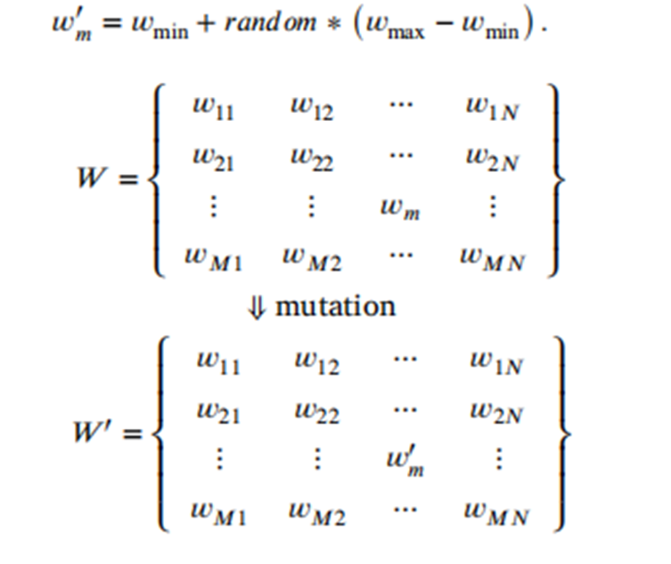

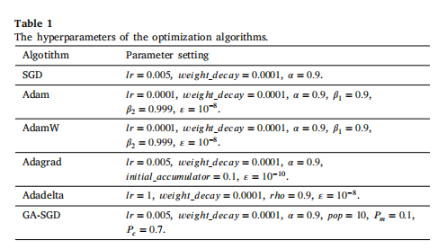
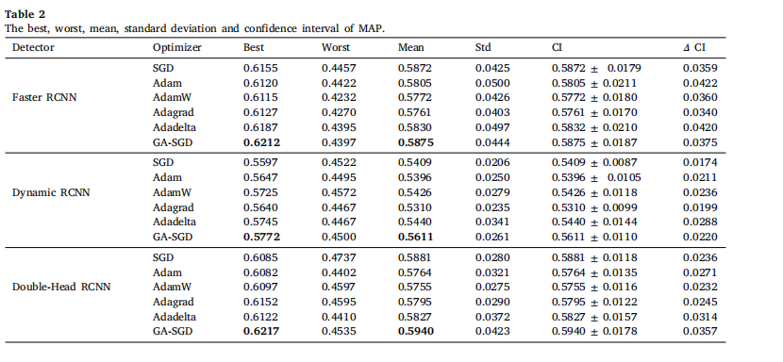
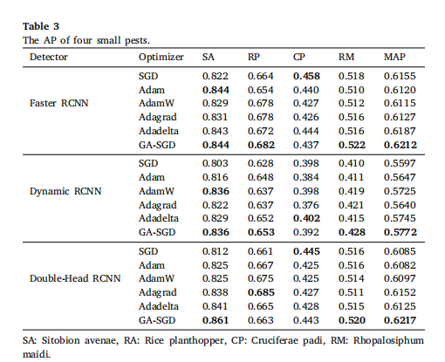
Field detection of small pests through Stochastic Gradient Descent with Genetic Algorithm (GA-SGD)
Group 7
Department of Computer Science – CSCD 612 – Intelligent Systems
Members’ IDs: Elorm Kevin 11004942; Abigail Quansah 11010320; Fred Blonty Tornu 11004605; Brandford Teku 11010650
Overview
Introduction: This study focuses on the challenges posed by small pests in agriculture and the need for accurate and timely detection to prevent economic losses. Traditional manual detection methods are labor-intensive and insufficient for real-time decision making. Leveraging computer vision and machine learning, the study explores the integration of Stochastic Gradient Descent and Genetic Algorithm to automate pest detection, aiming to improve accuracy and efficiency in precision agriculture.
Objective: The ultimate goal is to achieve accurate and real-time detection of small pests, such as insects and mites, in agricultural fields, thereby minimizing crop damage, enhancing crop health, and supporting sustainable farming practices.
Methodology:This paper uses the small pest dataset Agripest to verify the algorithm performance. The dataset consists of four tiny pests (Sitobion avenae of wheat; Planthopper of rice; Cruciferae padi of rape; Rhopalosiphum maidis of corn), and the image resolution is 1440*1080, including the training set of 772 images and the test set of 148 images.
Proposed Solution: The current training method of the pest detection model is Stochastic Gradient Descent, which is easy to fall into local optimum, so the loss function parameters of the pest detection model are difficult to optimize, resulting in poor accuracy of pests detection. The paper then propose an efficient training algorithm, named Genetic Algorithm - Stochastic Gradient Descent (GA-SGD), for the pests detection models.
Results: The best and mean of MAP reveal that GA-SGD is superior to five algorithms in detection accuracy. The boxplots of three optimizers show that the performance of GA-SGD is relatively stable. The data reveals that four small pests are detected through GA-SGD with superiority.
Planthopper of rice; Cruciferae padi of rape; Rhopalosiphum maidis of corn). Compared with the five algorithms, the higher detection accuracy and stability are obtained by GA-SGD.
Problem Statement
Crossover Operation
The problem described here is the difficulty in improving the object detection accuracy of a complex small pests detector, which is a deep neural network trained using stochastic gradient descent. This difficulty arises from the network's tendency to get trapped in local optima during the optimization process, preventing the achievement of better parameter optimization and consequently hindering the enhancement of object detection accuracy.
Mutation Operator
Relevance of Algorithm
This study introduces three evolution strategies to improve the original SGD algorithm, which are selection operation, crossover operation and mutation operation.
Conclusion
The best and mean of MAP reveal that GA-SGD is superior to five algorithms in detection accuracy.
The boxplots of three optimizers show that the performance of GA-SGD is relatively stable.
Experimental Approach
The Proposed Algorithm
Firstly, the solution set of the initial population is generated according to the neural network parameters output by SGD, and then the excellent solution set is selected by the roulette wheel method. Crossover operation and mutation operation are performed on the selected solution set. The random disturbance is performed through these two operations to help SGD jump out of the local optimal trap, and better model parameters are trained by GA-SGD to obtain higher accuracy of small pests detection in the field.
Future work
• The SGD algorithm is executed to output the neural network parameter matrix 𝑊 .
• The output value 𝑊 of the SGD is used to initialize the population of GA.
• GA performs selection operation, crossover operation, and mutation operation to further optimize parameter 𝑊 . Finally, 𝑊 is returned to the loss function
In future work, the evolutionary algorithm applied in small pests detection will be further extended. The evolutionary algorithm optimizes the parameters of deep neural networks in this paper. The current two stage detection network structure is not the optimal form in the field of pests recognition. We will use evolutionary algorithms to automate the design of the neural network structure based on feedback from the accuracy of small pests detection. In the future, the evolutionary algorithm is applied to optimize both the parameters and the structure of the neural network to design the best neural network model for small pests detection.
Result
Selection Operation
Selection operation picks individuals with higher fitness values from the old population to create the new population for the next generation. The probability of selection is directly related to an individual's fitness value. Higher fitness values increase the likelihood of being chosen. The fitness value of the individual 𝑊 is 𝑓𝑊 . Since it is a minimization problem, the fitness function is the reciprocal of the objective function. A random number is generated between the interval [0,1], and the random number is in which probability range, which individual is selected. If an individual has a high probability of selection, it has a chance to be selected multiple times, then its values will be expanded in the population; if an individual has a small probability of selection, it will have a high probability of being eliminated
Research Contributions
References
1. Due to the features of small pests in the field are not obvious, the small pests detection networks are usually deep models. An optimization algorithm based on evolution strategies to address the problem that SGD cannot efficiently train deep models is proposed.
2. For the premature convergence problem of the stochastic gradient descent method, we propose stochastic gradient descent with genetic algorithm (GA-SGD) based on selection strategy, crossover and mutation strategy to improve the performance of the basic SGD.
3. Three object detectors are trained using GA-SGD for the field detection of four small pests (Sitobion avenae of wheat;
Antonakopoulos, K., Mertikopoulos, P., Piliouras, G., Wang, X., 2022. AdaGrad avoids
saddle points. In: International Conference on Machine Learning. PMLR, pp.
731–771.
Antonio, L.M., Coello, C.A.C., 2017. Coevolutionary multiobjective evolutionary al_x0002_gorithms: Survey of the state-of-the-art. IEEE Trans. Evol. Comput. 22 (6),
851–865.
Bay, H., Tuytelaars, T., Gool, L.V., 2006. Surf: Speeded up robust features. In: European
Conference on Computer Vision. Springer, pp. 404–417.
Bertens, P., Lee, S.-W., 2020. Network of evolvable neural units can learn synaptic
learning rules and spiking dynamics. Nat. Mach. Intell.

